Slide 1
Database •Database may be defined in simple terms as a collection of data •A database is a collection of related data. •The database can be of any size and of varying complexity. • A database may be generated and maintained manually or it may be computerized.
Database Management System •Database Management Systems (DBMS) are software systems used to store, retrieve, and run queries on data. • A DBMS serves as an interface between an end-user and a database, allowing users to create, read, update, and delete data in the database. • A DBMS is a collection of program that enables user to create and maintain a database.
Characteristics of DBMS DataDefinition schema
• Security and Access Control Management • Data Recovery and Backup Data Manipulation • Scalability
• Transaction Management • Data Independence Query Optimization • Query Language Support • Security and Access Control • Backup and Recovery

Slide 2
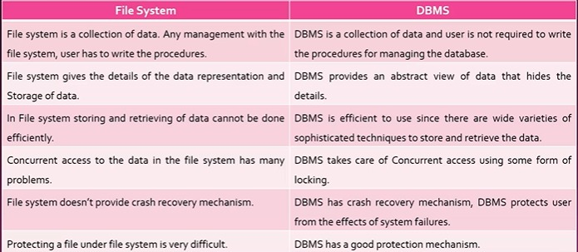
DBMS Utilities A data loading utility: •Which allows easy loading of data from the external format without writing programs. A backup utility: •Which allows to make copies of the database periodically to help in cases of crashes and disasters. • Recovery utility: •Which allows to reconstruct the correct state of database from the backup and history of transactions.
DIFFERENTBETWEEN FILE SYSTEM AND DATABASE

Slide 3
ADVANTAGE of dbms
Types of dbms
Relational DBMS (RDBMS), Hierarchical DBMS,
Network DBMS, Object-Oriented DBMS (OODBMS), NoSQL DBMS, Columnar DBMS, and In-Memory DBMS
• Data independency • Efficient data access • Data integrity and security • Data Administration • Concurrent access and Crash recovery • Reduced application development time
Relational DBMS:-
• It is based on SQL. • A relational database management system. • This is one of the most popular data models which is used in industries. • Every table in a database has a key field which uniquely identifies each record. • RDBMS is a system where data is organized in two-dimensional tables using rows and columns.
Disadvantage of dbms
Cost. Complexity. Scalability. Dependence on technology. Performance issues. Data integration. Security. Data loss/corruption.

Slide 4
ObjeOriented DBMS:-
Object Oriented Database • It is a combination of relational database concepts and object-oriented principles. • OOPs principles are data encapsulation, inheritance, and polymorphism. • It requires less code and is easy to maintain. • For example – Object DB software.
Network Database A Network database management system. • This maintain one to one relationship (1: 1) or many to many relationship (N: N). It is based on a network data model, which allows each record to be related to multiple primary records and multiple secondary records.
DBMS language
Data definition language (DDL) ... Data manipulation language (DML) ... Data control language (DCL) ... Transaction control language (TCL)
Hierarchical DBMS
Parent-Child Relationship. A parent node exists for each child node. ... One-to-many Relationship. The data is organised in a tree-like form, with the datatypes having a one-to-many relationship. ... Deletion Problem. When a parent node is removed, the child node is removed as well. Pointers.

Slide 5
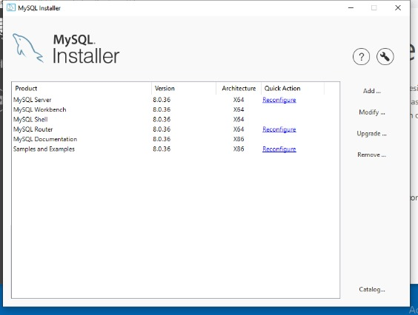
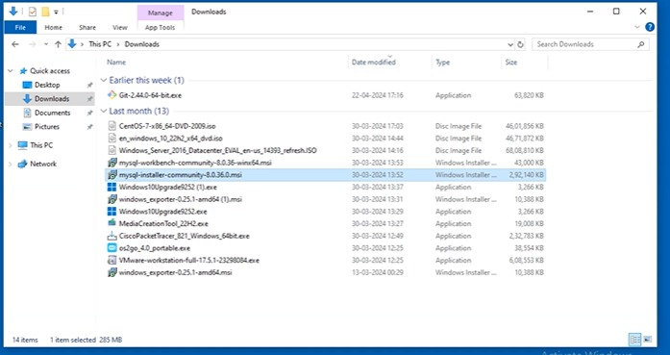
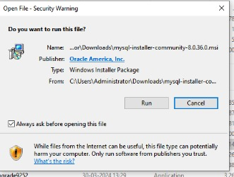
-:INSTALLATION OF MYSQL :-
Install MySQL community
Step1-Go to download and clk on MySQL installer comuni
Step2- Click on run and installit.

Slide 6
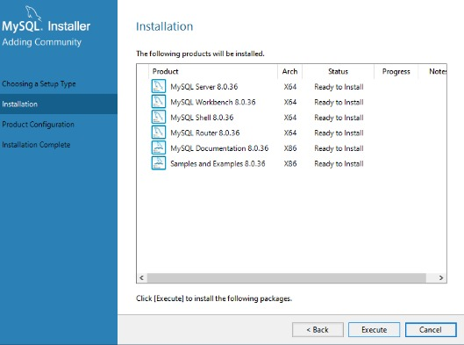
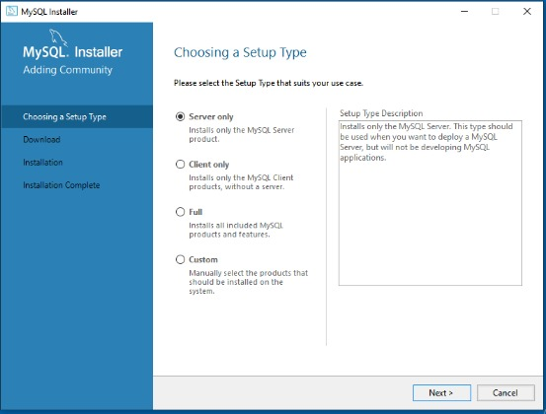
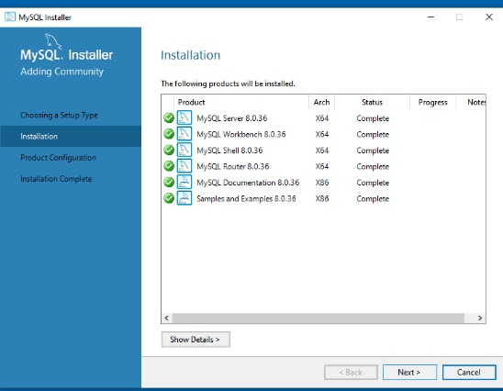
Click on execute and next
Click on full and next

Slide 7
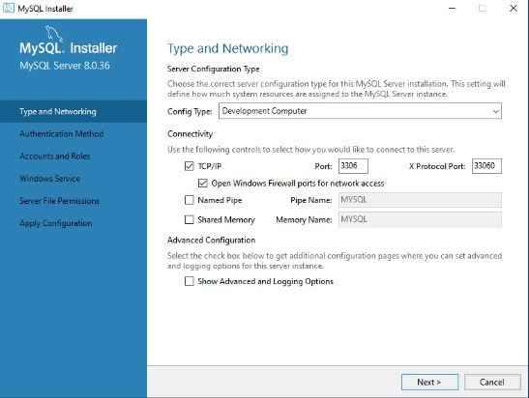
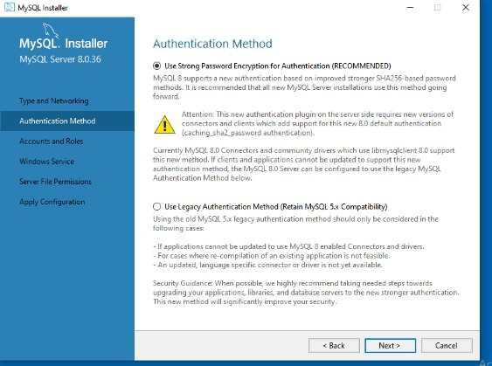
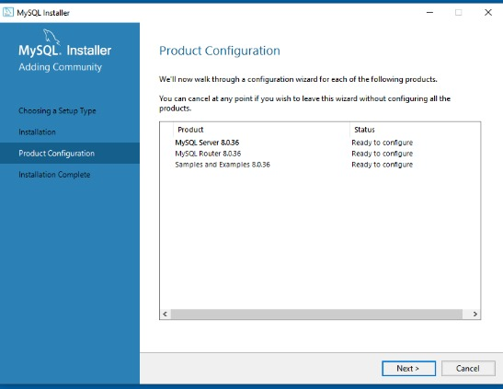
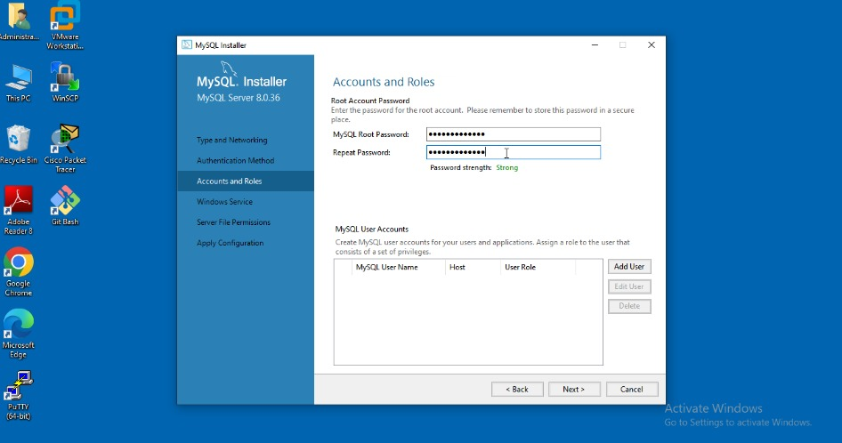
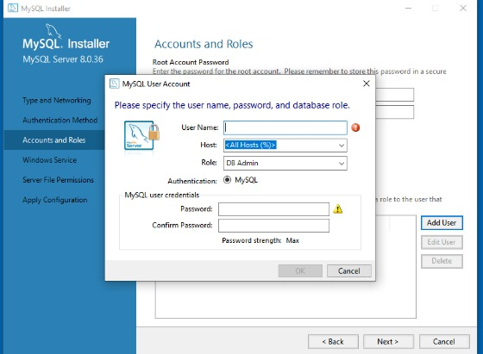
Enter the password
Add user and pswd

Slide 8
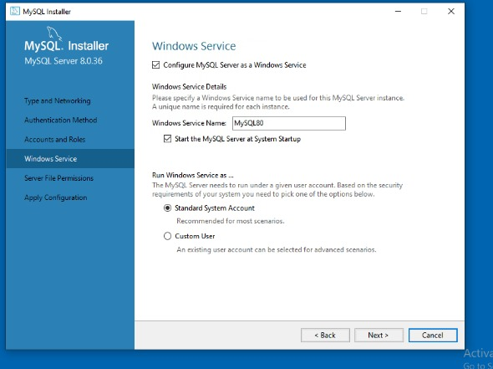
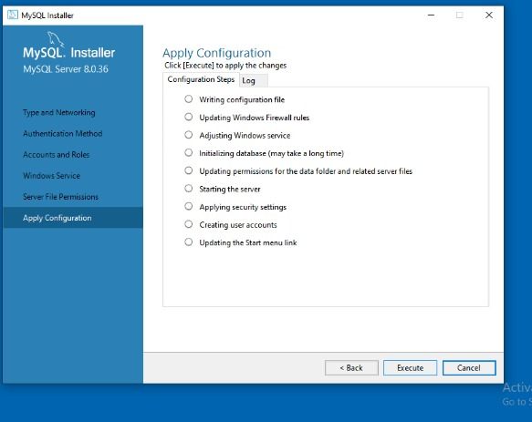
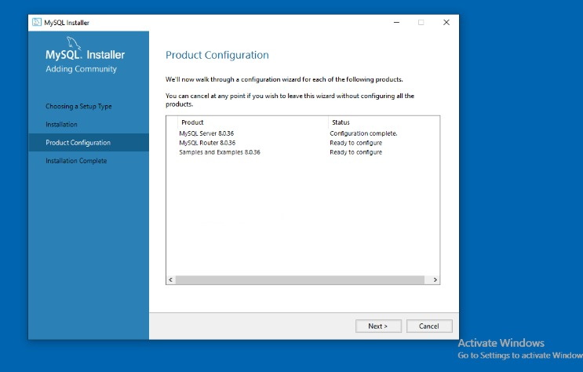
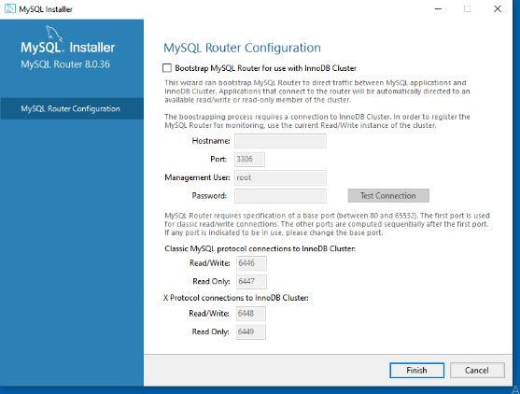
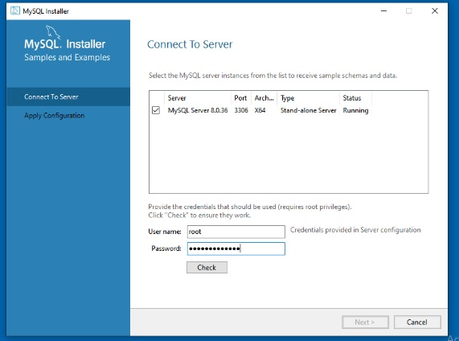
Type user and pswd and

Slide 9
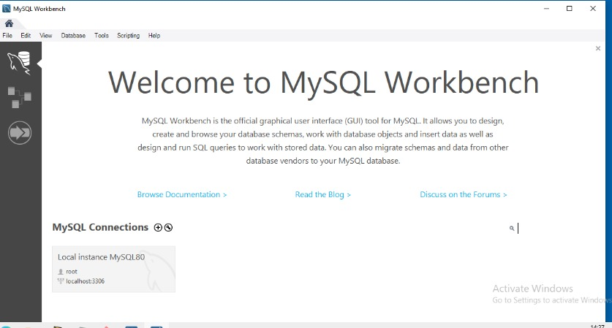
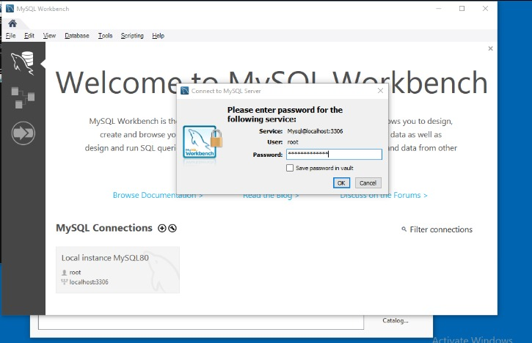
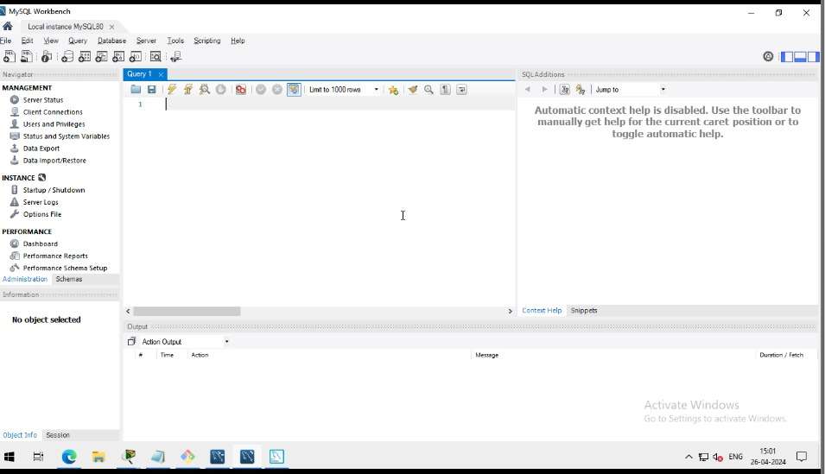
Click on this
Enter the password

Slide 10
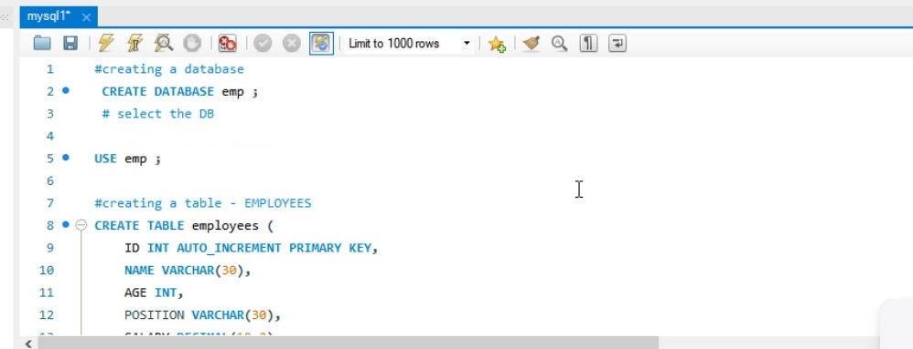
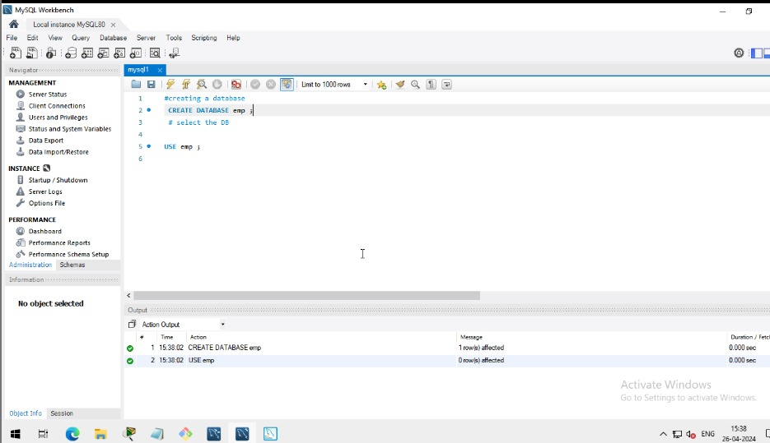
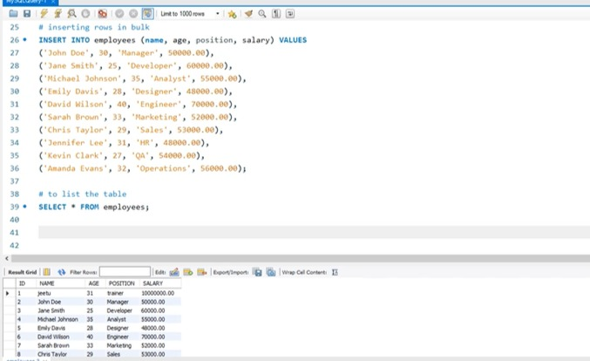
Create a database

Slide 11
# creating a database CREATE DATABASE emp; # select the DB USE emp; # creating table – EMPLOYEES CREATE TABLE employees( ID INT auto_increment primary key, NAME varchar(30), AGE INT, POSITION varchar(30), SALARY decimal(10,2) ); # to list the table SELECT * FROM employees; # inserting 1st row in the table. INSERT INTO employees (name, age, position, salary) value (‘jeetu’, 31, ‘trainer’, 10000000.00); # to list the table SELECT * FROM employees;

Slide 12
# inserting rows in bulk INSERT INTO employees (name, age, position, salary) VALUES (‘John Doe’, 30, ‘Manager’, 50000.00), (‘Jane Smith’, 25, ‘Developer’, 60000.00), (‘Michael Johnson’, 35, ‘Analyst’, 55000.00), (‘Emily Davis’, 28, ‘Designer’, 48000.00), (‘David Wilson’, 40, ‘Engineer’, 70000.00), (‘Sarah Brown’, 33, ‘Marketing’, 52000.00), (‘Chris Taylor’, 29, ‘Sales’, 53000.00), (‘Jennifer Lee’, 31, ‘HR’, 48000.00), (‘Kevin Clark’, 27, ‘QA’, 54000.00), (‘Amanda Evans’, 32, ‘Operations’, 56000.00); # to list the table SELECT * FROM employees; # selective listing select * from employees where salary > 50000; select * from employees where name=“arghya”; select * from employees where salary > 50000 AND age > 30; # updating the value: update employees set salary = 80000.00 where name = ‘arghya’; select * from employees where name=“arghya”; # delete the user entry whose age is greater than 40 Yrs. Select * from employees where age >= 40; delete from employees where age >= 40; SELECT * FROM employees;

